Slide 1
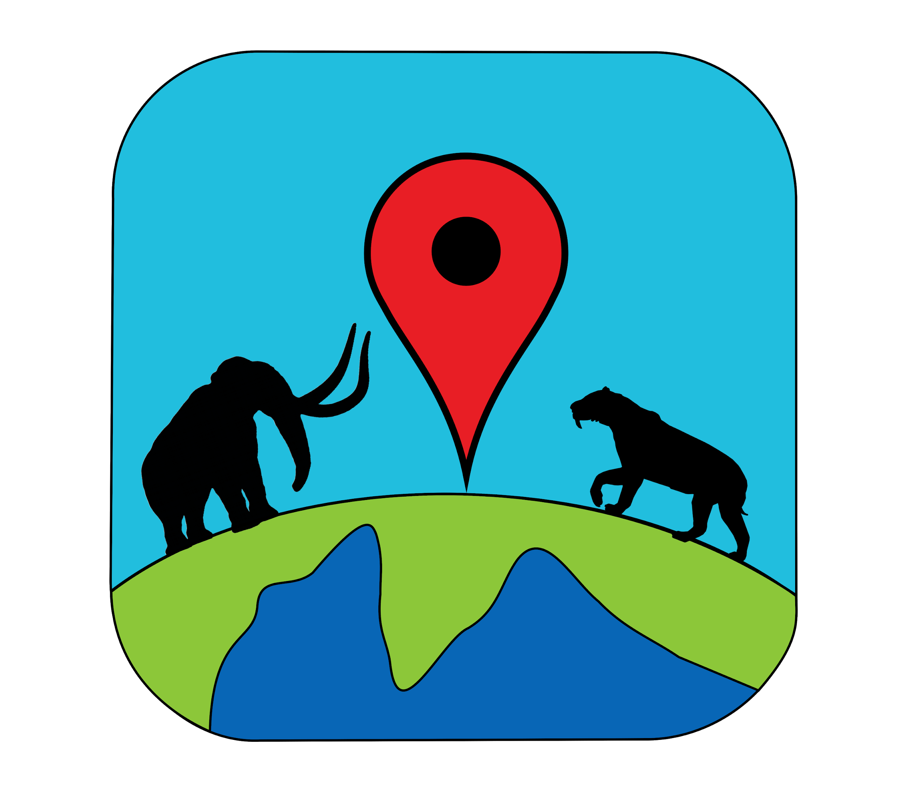
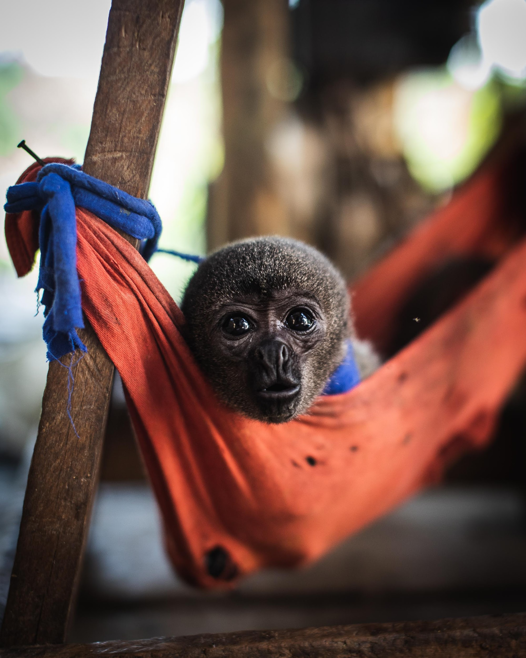
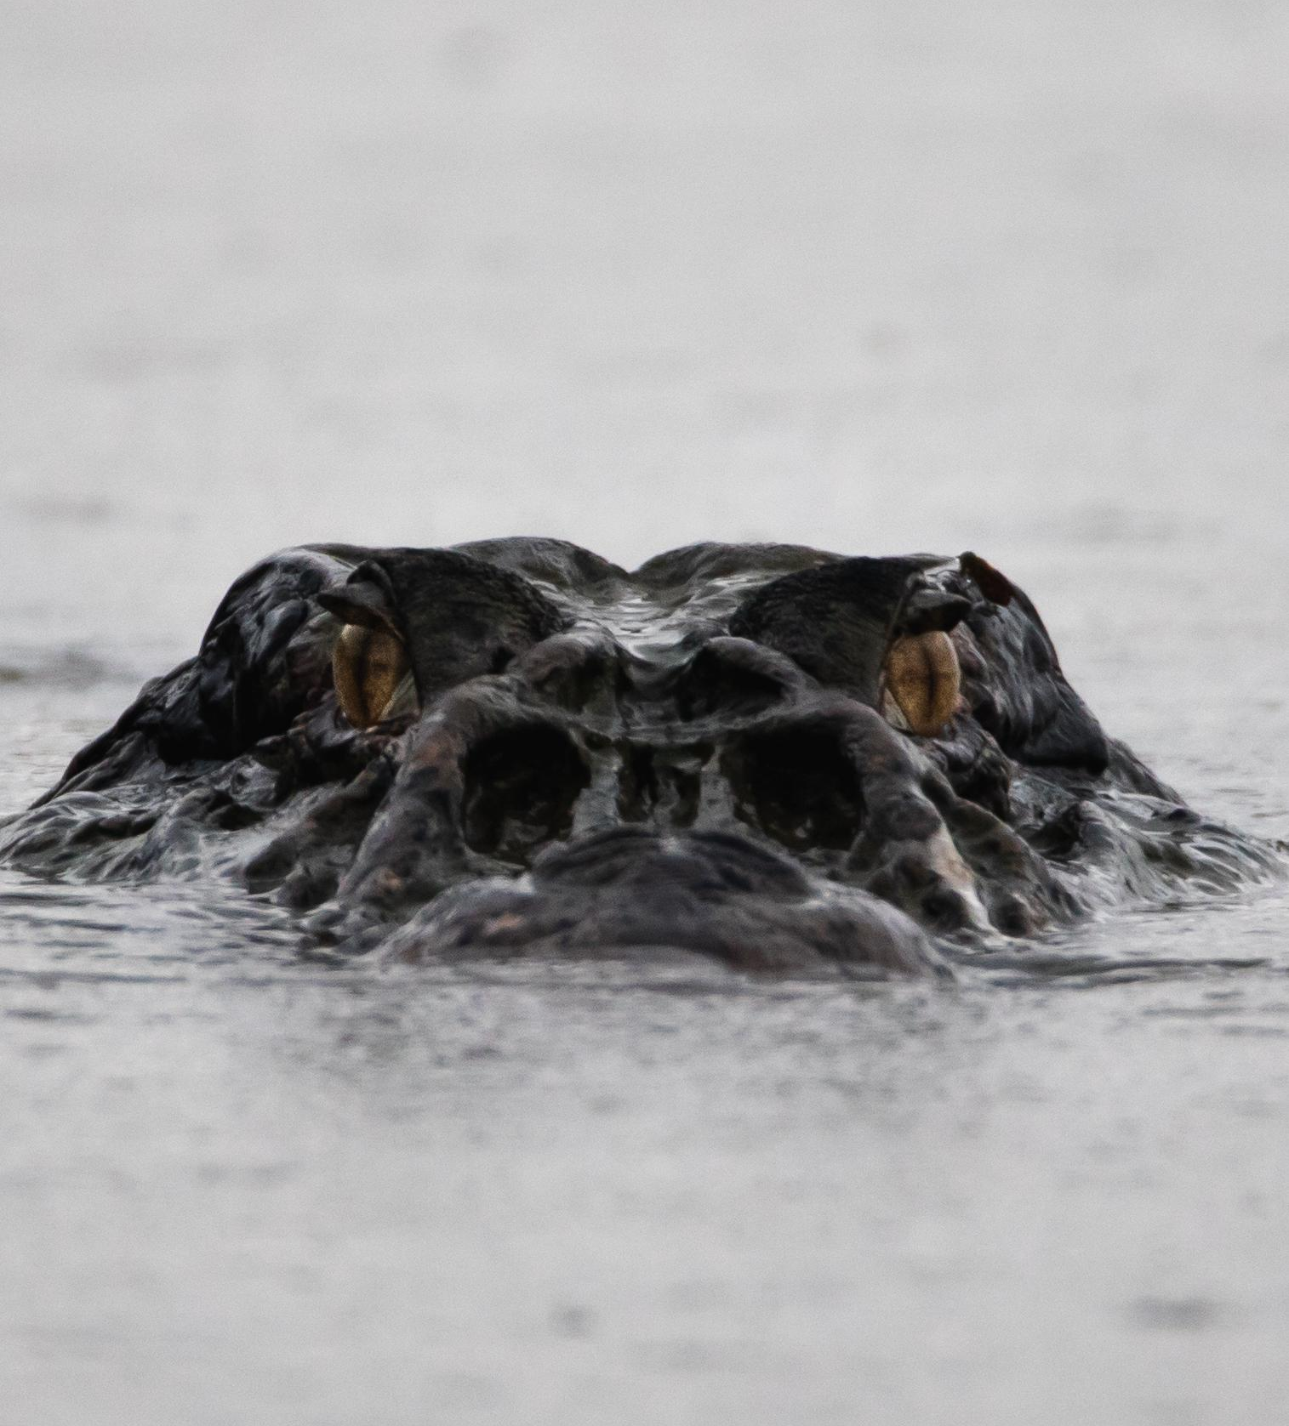
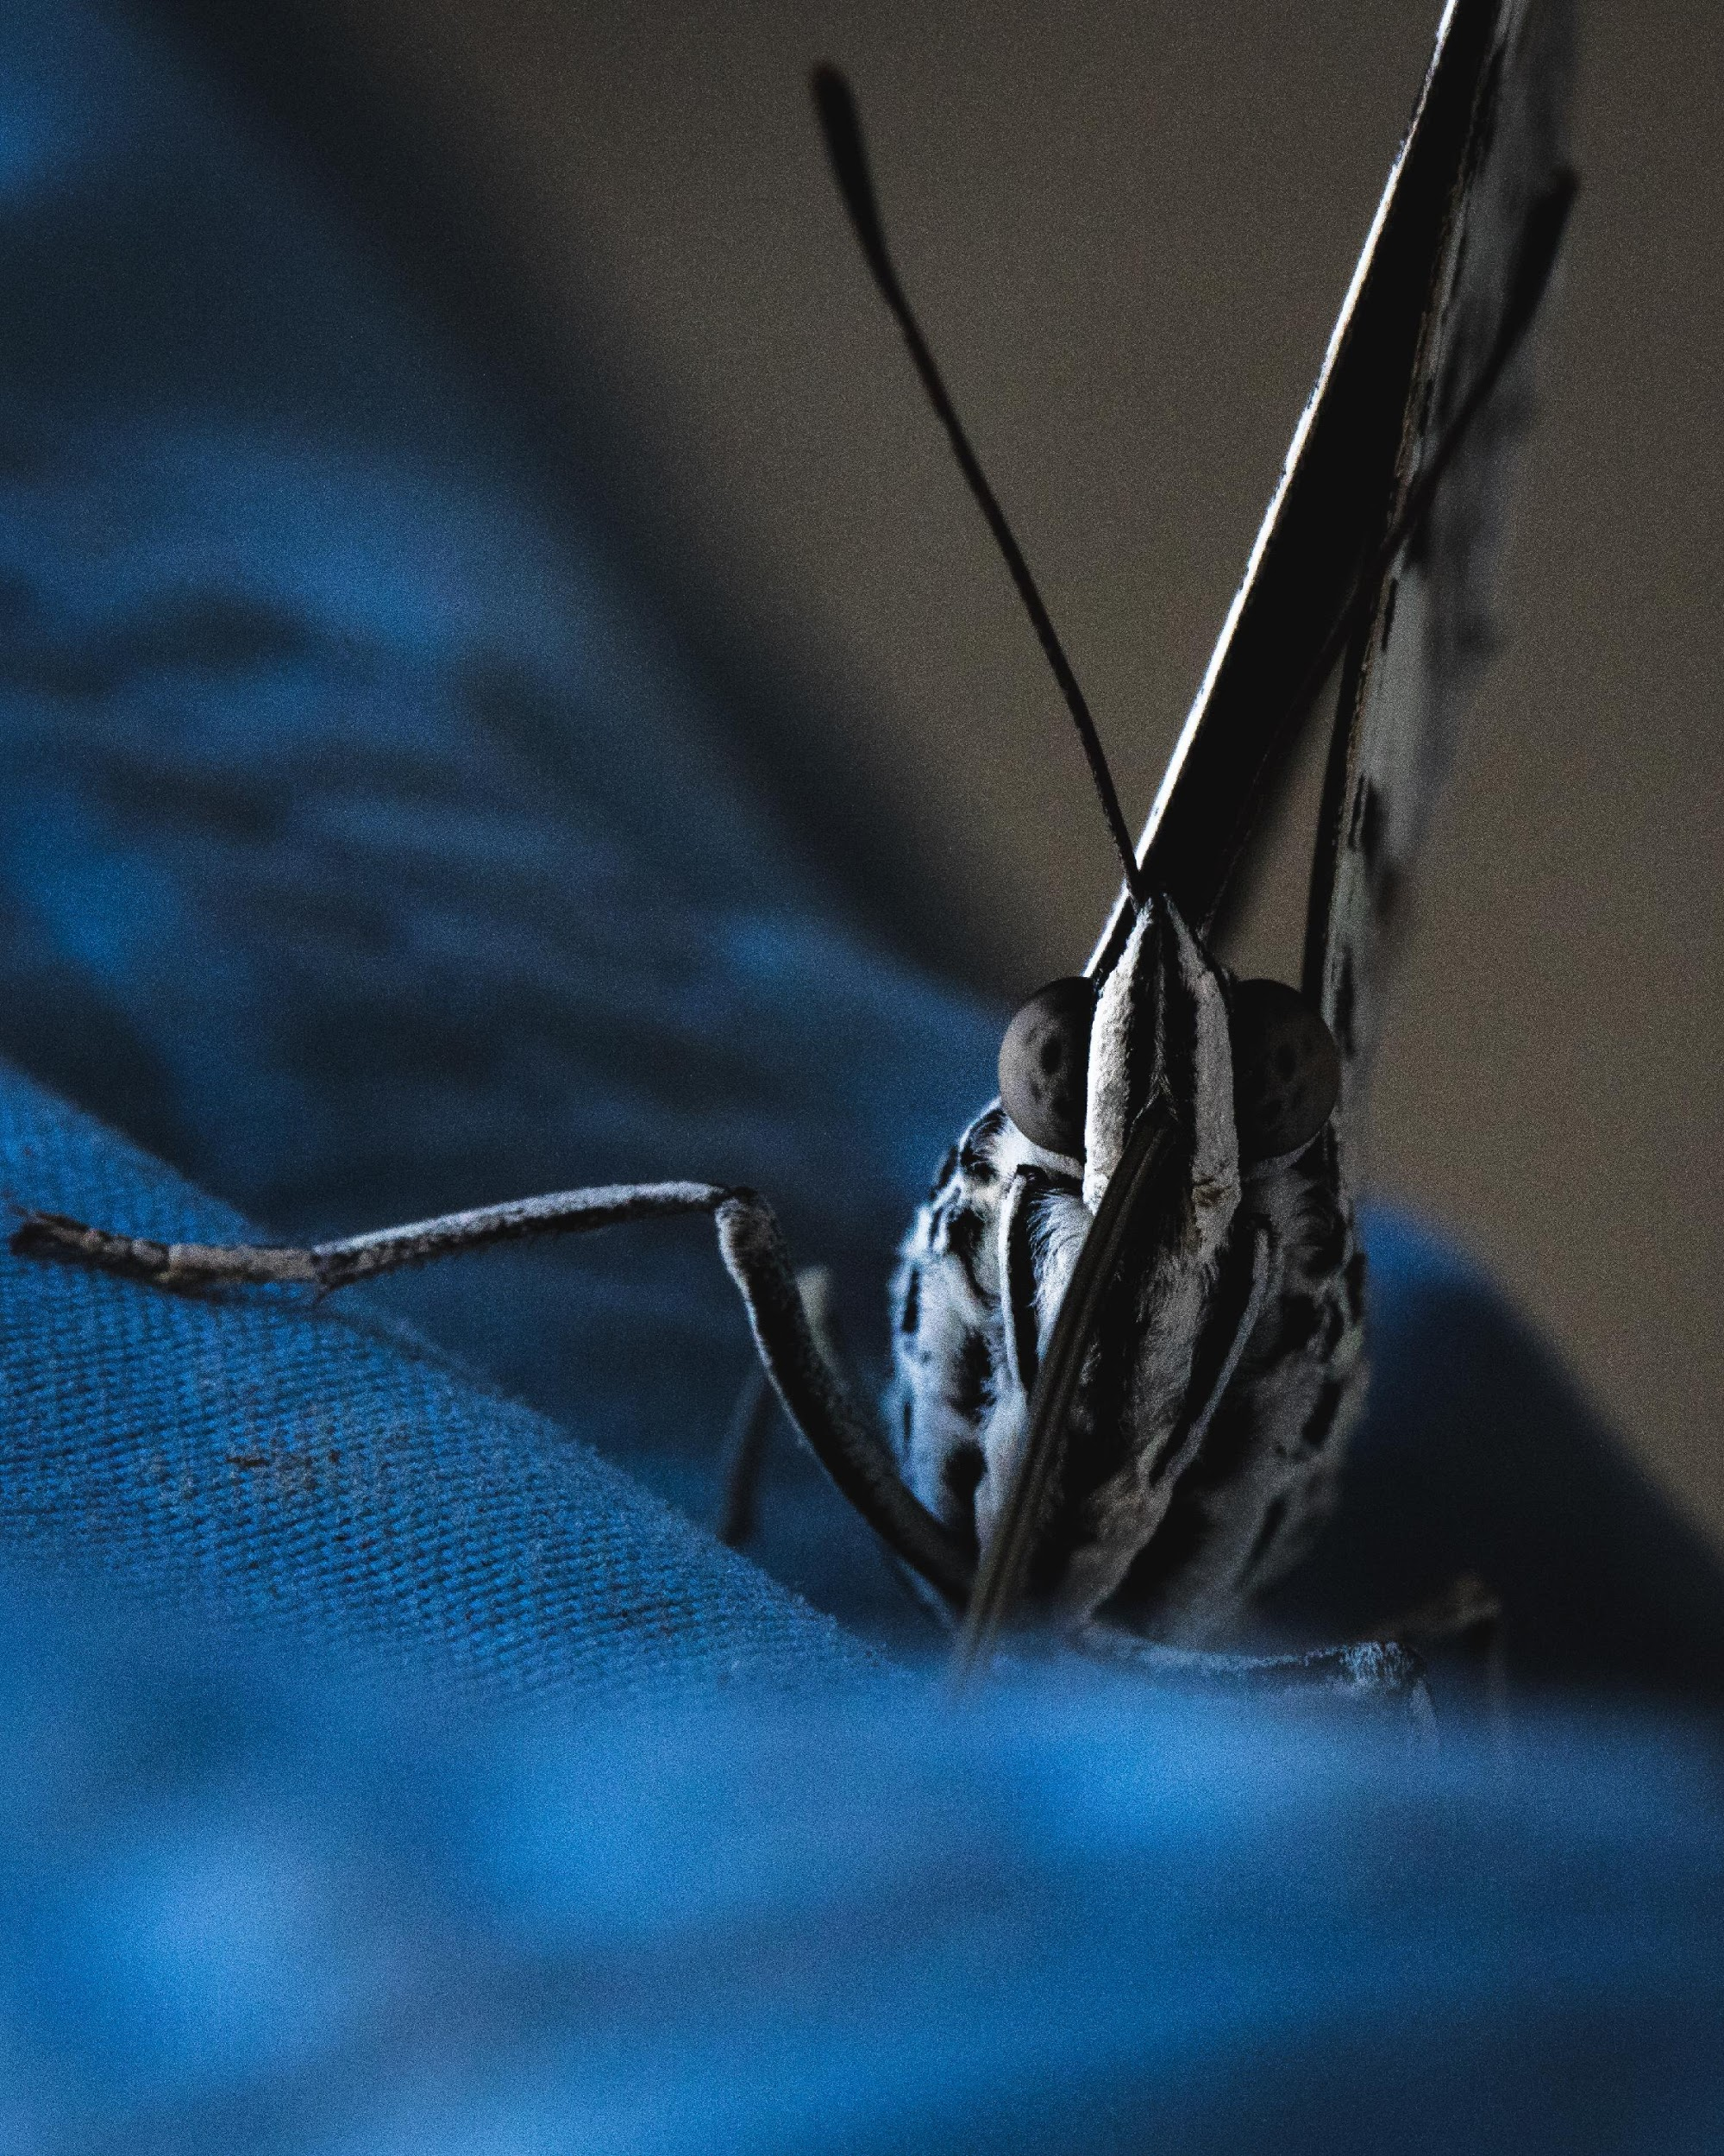
Big Animals
Big Animals
Produced for: {}
Date downloaded: {}

Slide 2
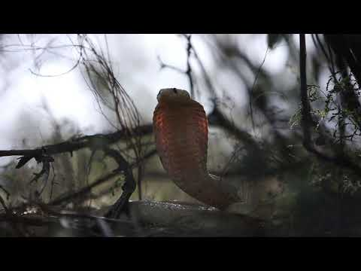

Slide 3
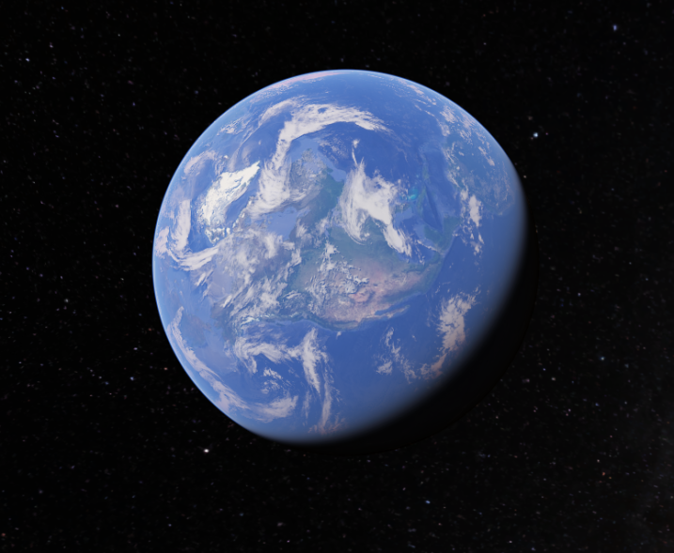
Where are you?
Click here
Notes:
This is a link to Google Earth.

Slide 4
First of all, let’s start with the largest animal in the world?
Notes:
1

Slide 5
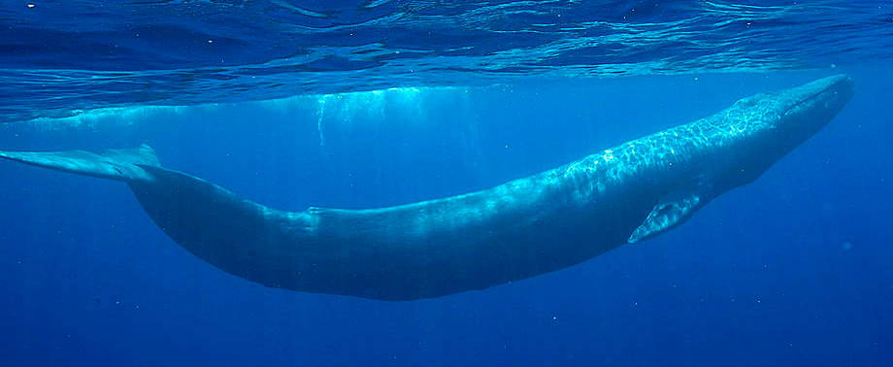
It’s the blue whale!
Notes:
1

Slide 6
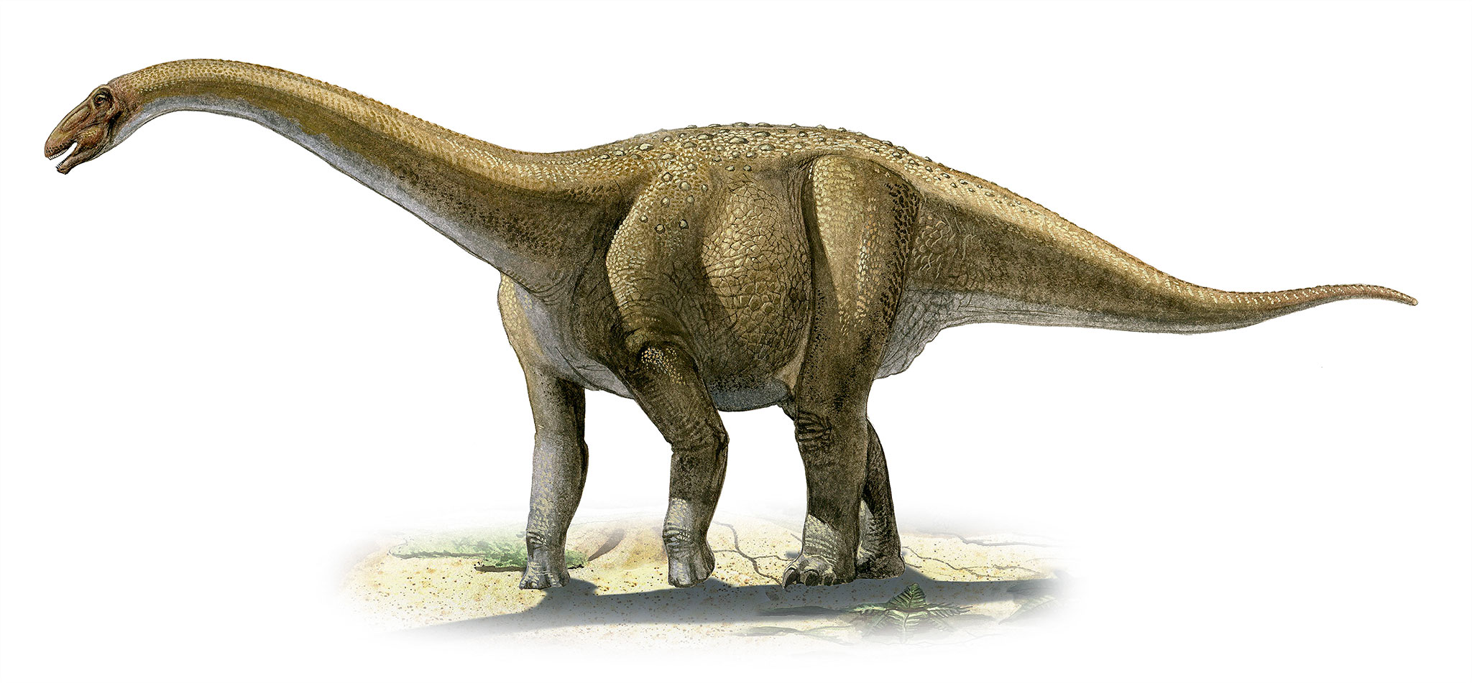
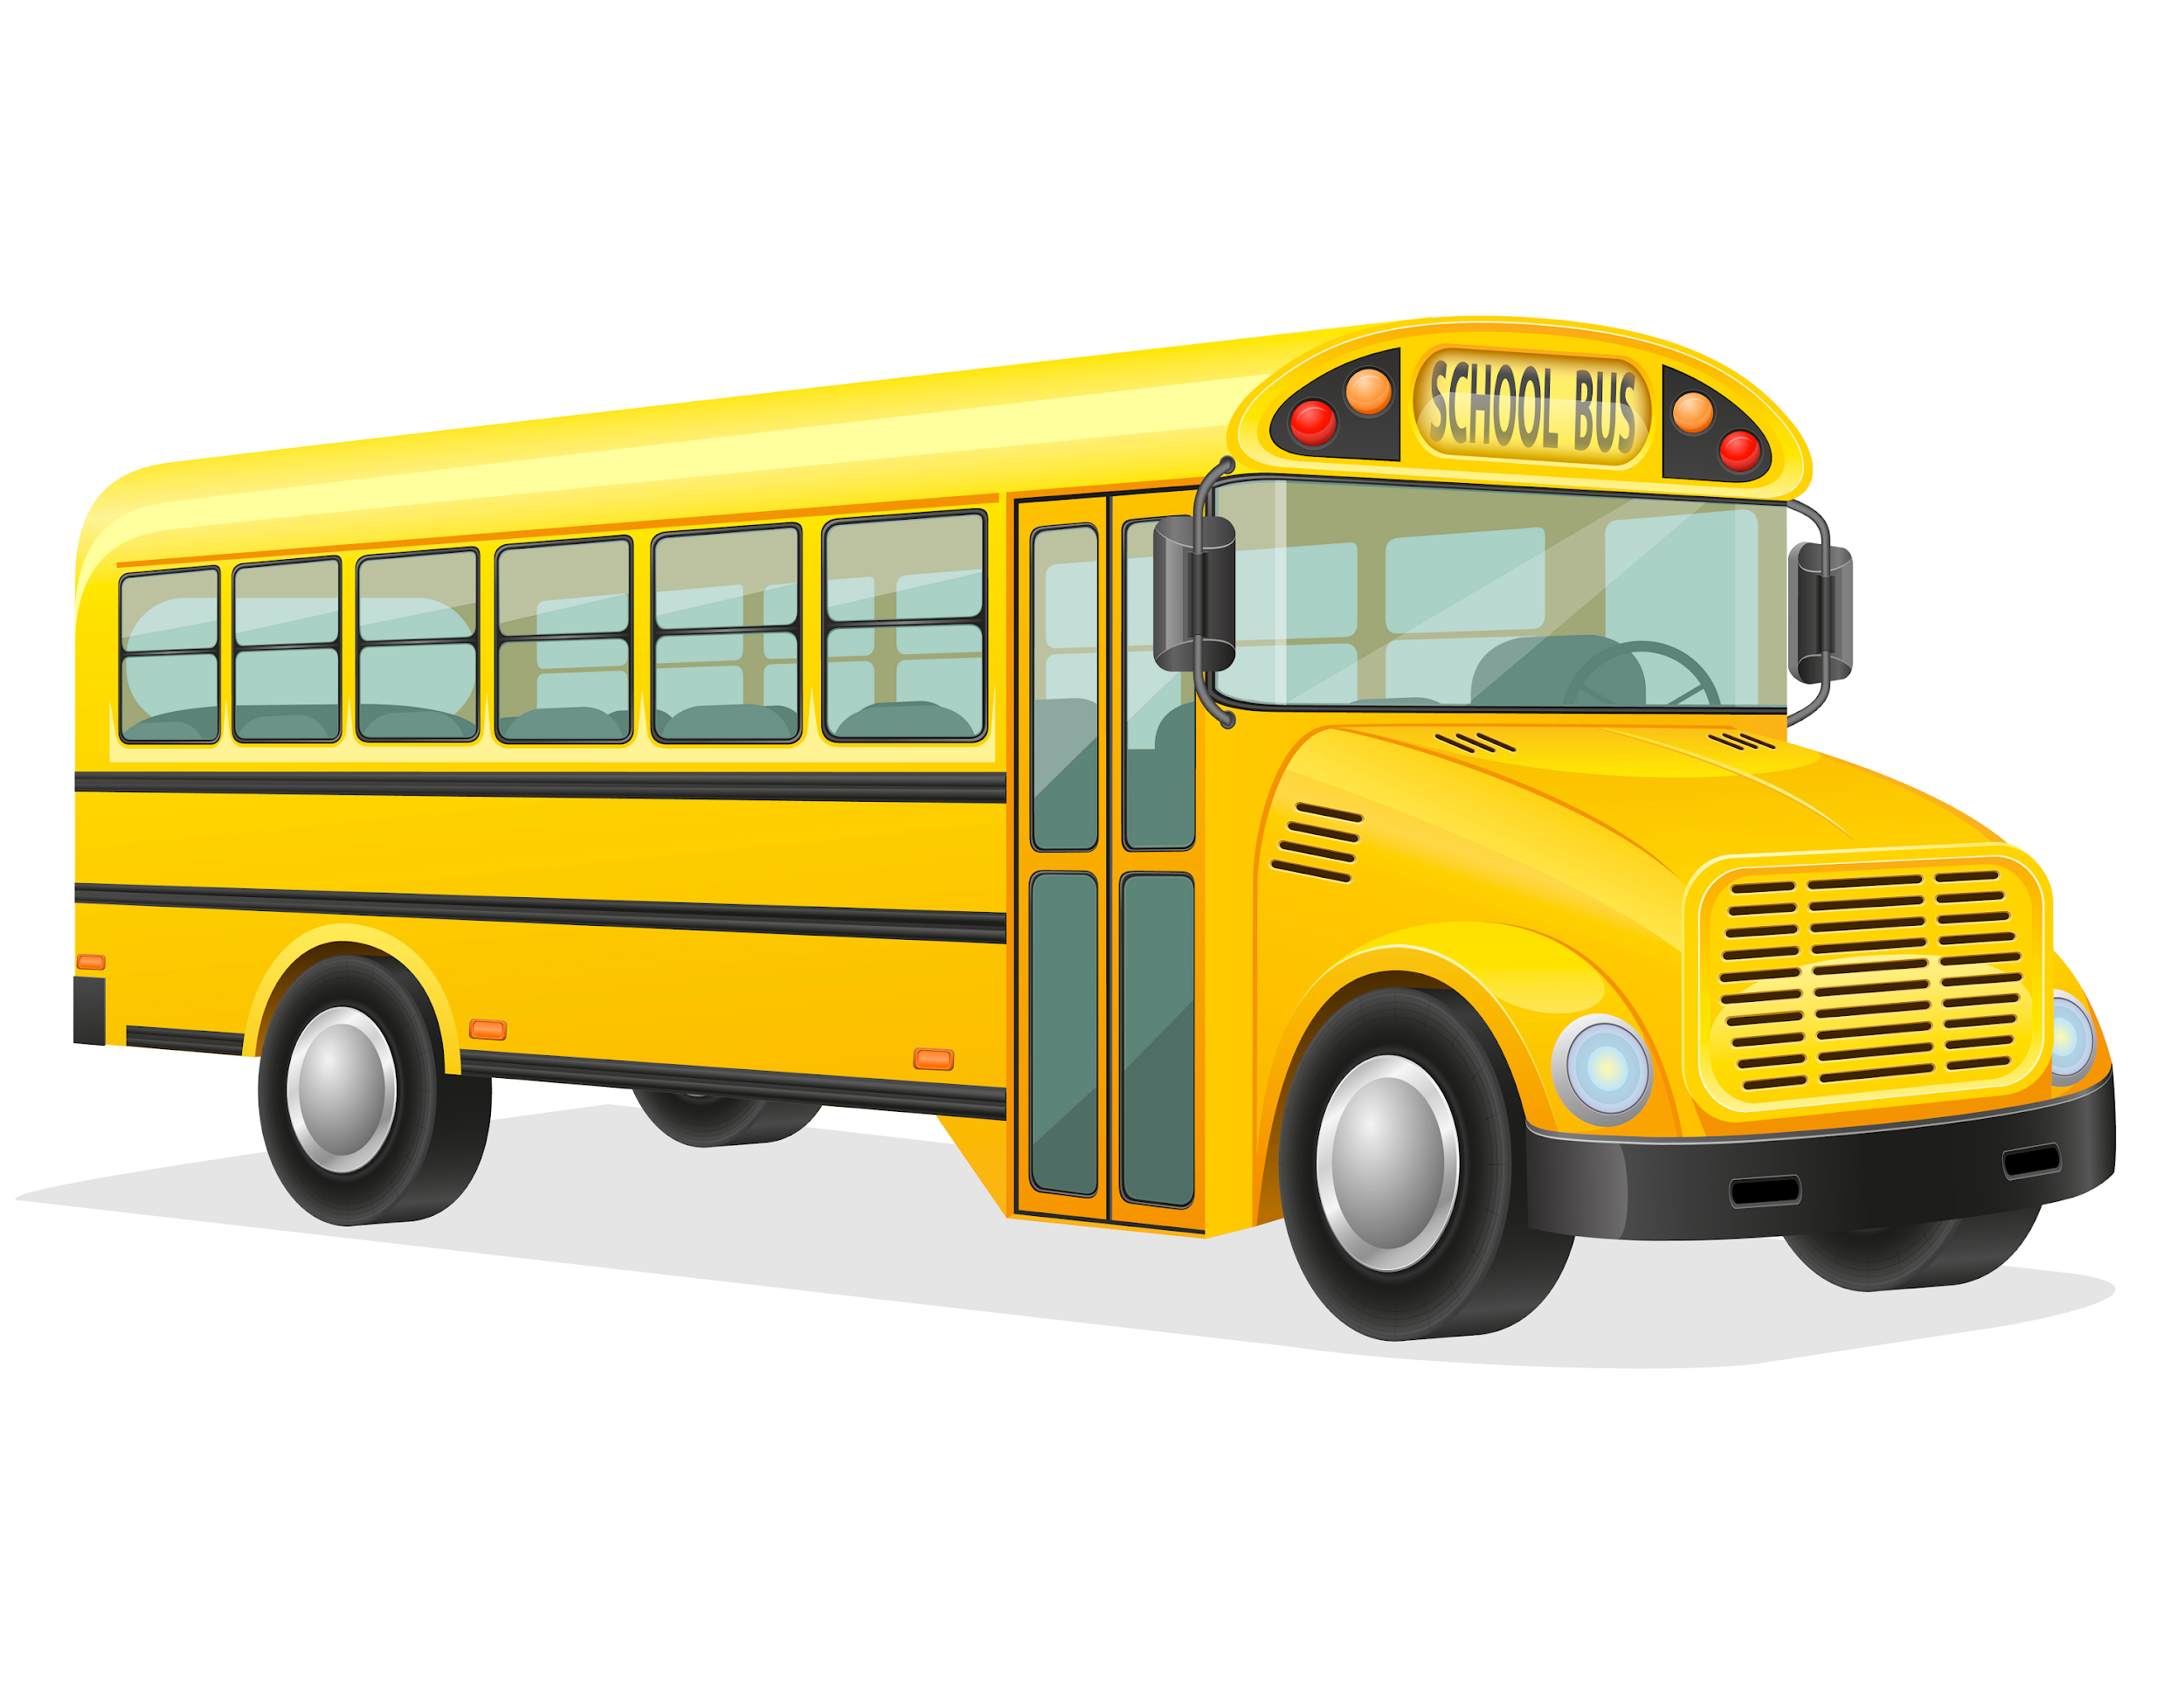
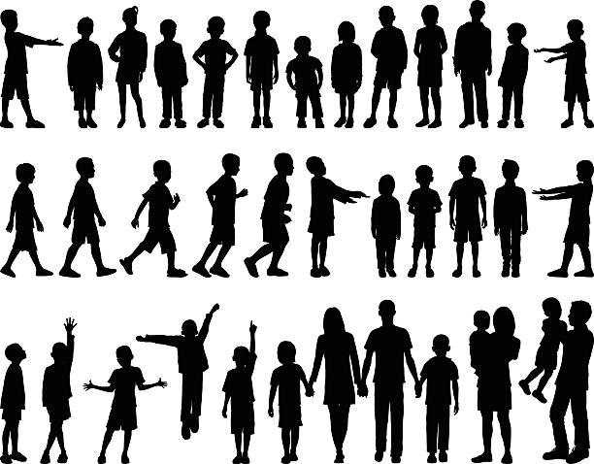
Did you know...
The blue whale is the largest animal to have ever existed, bigger even than all the dinosaurs.
A blue whale weighs the same as three school buses.
That’s equal to 4000 children!
Notes:
1

Slide 7
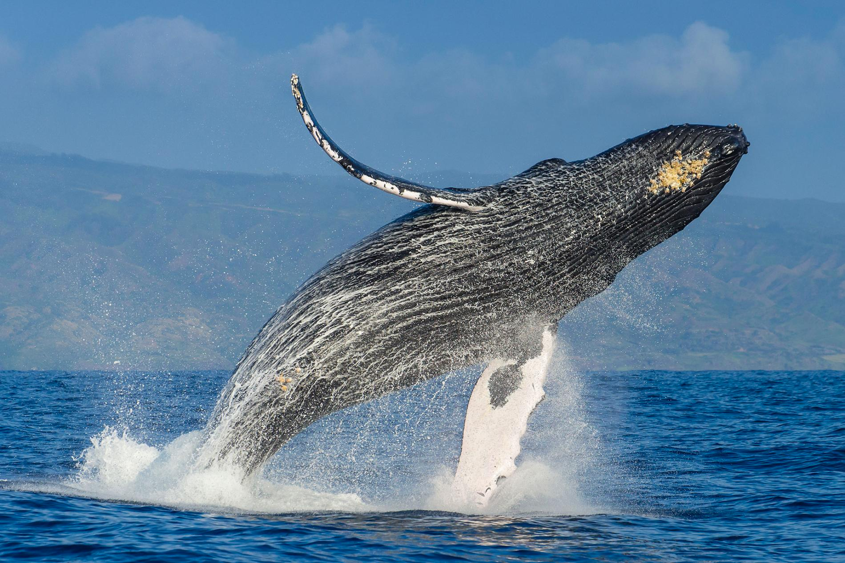

Whales can communicate over large distances with their song. You can listen here

Slide 8
Do you know what the largest animal on land is?

Slide 9
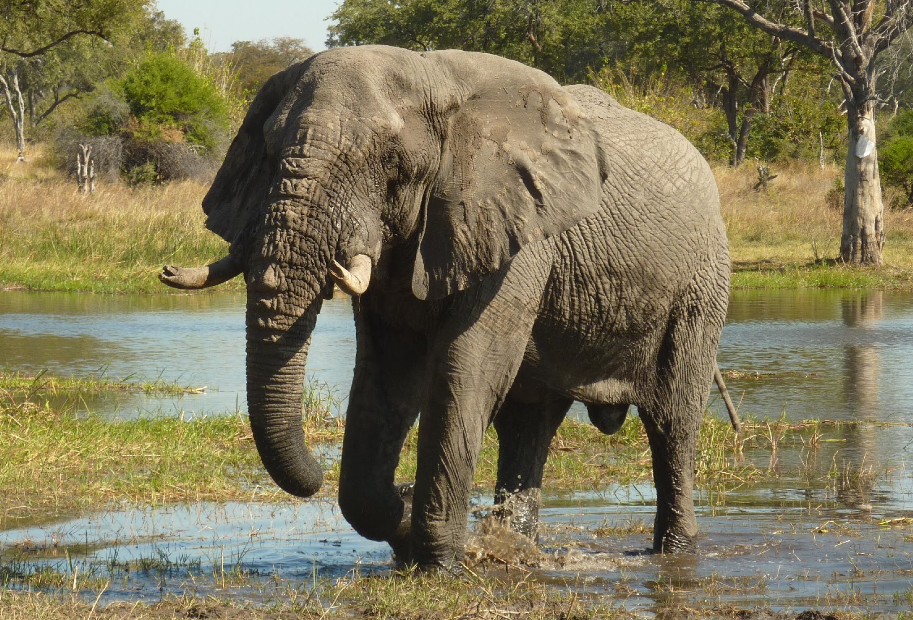
It’s the African elephant

Slide 10
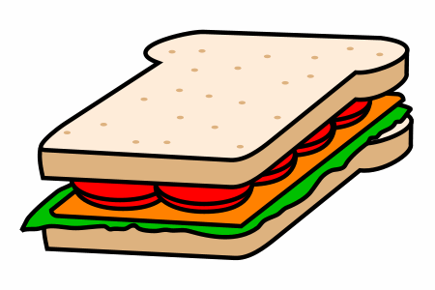
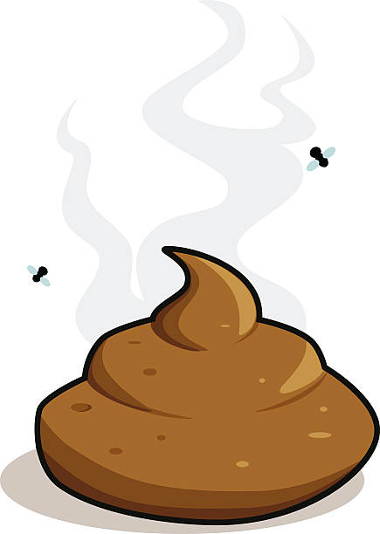
Did you know...
The African elephant can weigh over 5 tonnes, or the same as 150 children.
An African elephant can eat up to 300kg of plants per day. That’s the same weight as 600 school meals!
All that food means elephants poo...
A LOT!
Notes:
1

Slide 11
Okay, so how about the largest animal that lives near {}?

Slide 12

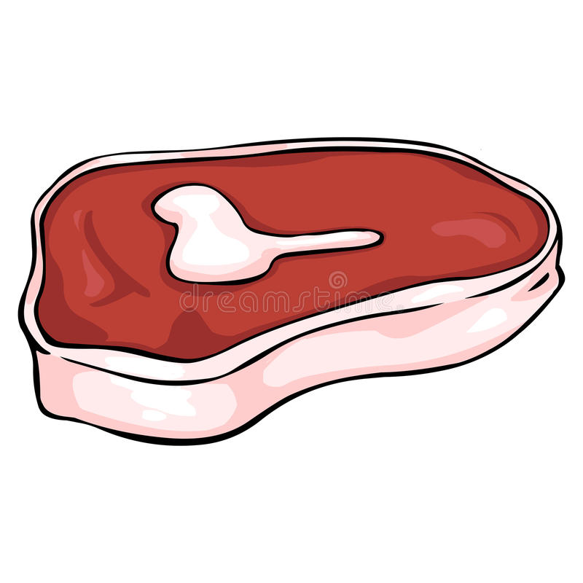
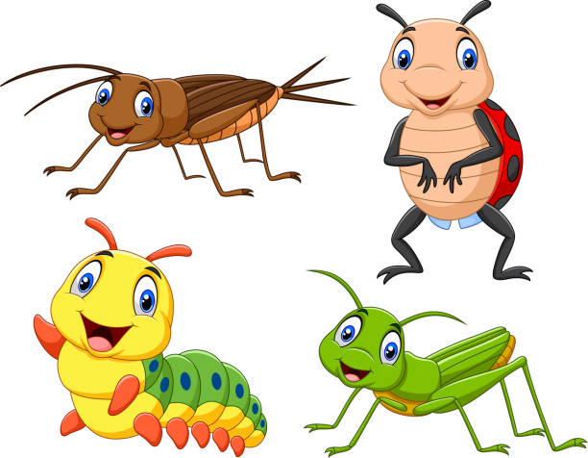
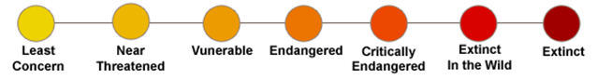
The {}…
Weighs in at {} kg…
And eats
{}% of plant,
{}% of meat,
and {}% of insects
And has an extinction threat level of {}.

Slide 13
How about the second largest animal near {}?

Slide 14
The {}…
Weighs in at {} kg…
And eats
{}% of plant,
{}% of meat,
and {}% of insects
And has an extinction threat level of {}.

Slide 15
Those are some big animals! But what about the largest predator?
Note: A predator is an animal that eats other animals

Slide 16
The {}…
Weighs in at {} kg…
And eats
{}% of plant,
{}% of meat,
and {}% of insects
And has an extinction threat level of {}.

Slide 17
And the second largest predator?

Slide 18
The {}…
Weighs in at {} kg…
And eats
{}% of plant,
{}% of meat,
and {}% of insects
And has an extinction threat level of {}.

Slide 19
Here are some pictures of the other large animals that live near {}. Can you name them?

Slide 20
{}
{}
{}
{}
{}
{}

Slide 21
But in the past, there were many more animals that lived near {}

Slide 22
The {} was the largest.
This giant weighed in at {} kg and ate...
{}% of plants
{}% of meat
, and {}% of insects

Slide 23
And the largest predator that is no longer here was..

Slide 24
The {} was the largest.
This giant weighed in at {} kg and ate...
{}% of plants
{}% of meat
, and {}% of insects

Slide 25
Here is a selection of animals that used to live near {}

Slide 26
{}
{}
{}
{}
{}
{}

Slide 27
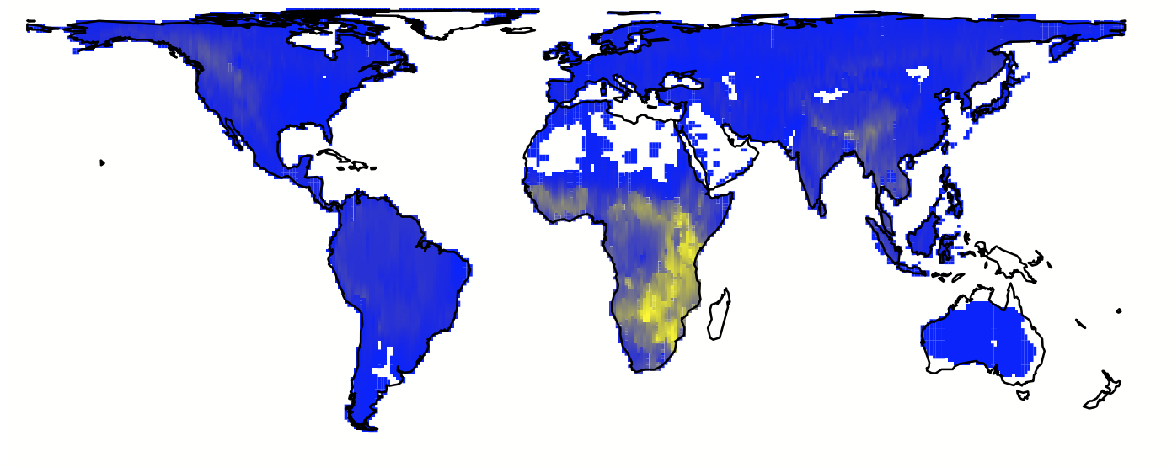
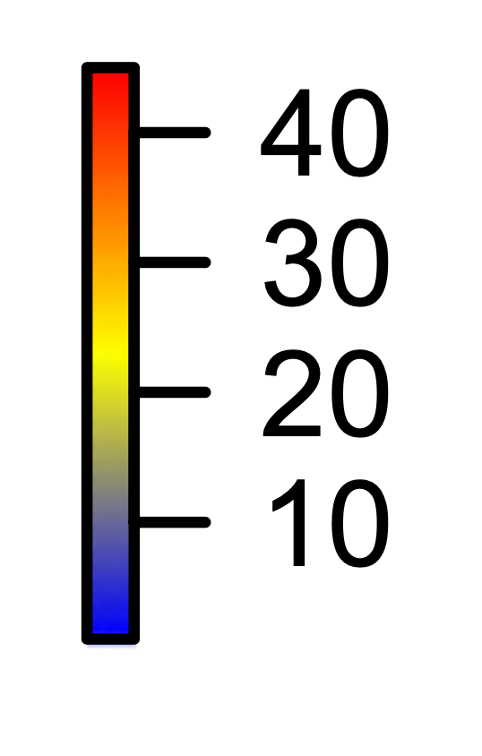
So, where do large animals live today?
The number of large animals (>44.5kg or 100lbs) living today
Notes:
1

Slide 28
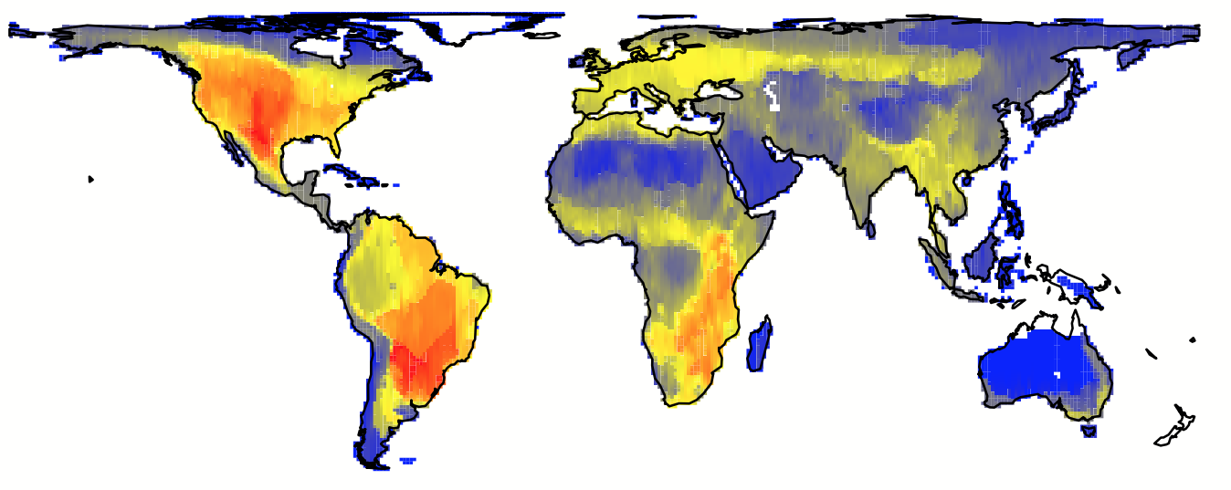
Across the whole world there were more large animals in the past
The number of large animals (>44.5kg or 100lbs) living in the past
Where did most large animals live in the past?

Slide 29
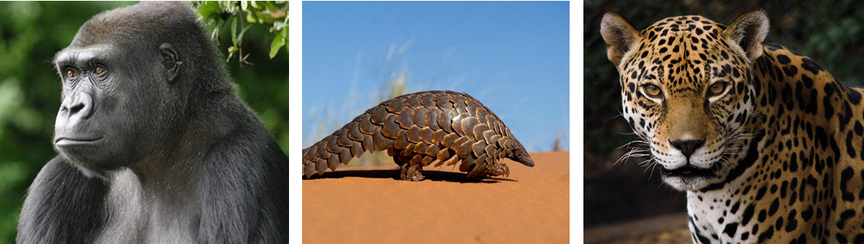
Today, the number of large animals is still falling
You can visit the WWF website here to look through a list of all large animals that are endangered

Slide 30
What things do you think you can do to help?

Slide 31
The Rules of Dobble
Each pair of cards has one matching image.
The first person to raise their hand, can answer which image is the same.
Can you think of something you’ve learned for that animal?

Slide 32
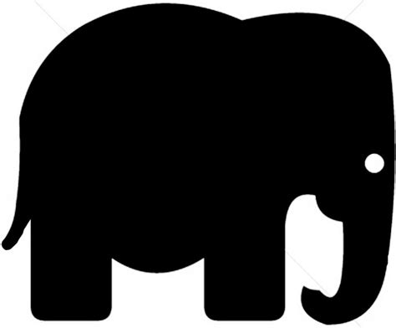
Dobble 1

Slide 33
Dobble 2

Slide 34
Dobble 3

Slide 35
Dobble 4

Slide 36
Dobble 5

Slide 37
Key learnings
There are cool animals that live near [insert school name]. But there used to be more in the past.
Big animals are important for a healthy planet.
We must protect animals for the future.

